Slide 1

R Package Development & My Analytics Workflow
Jake Riley
github.com/rjake

Slide 2


Jake Riley
Clinical Data Analyst
Data viz, maps
Tableau, Qlik, R
R Package development
simplecolors
shinyobjects
headliner
whereiation

Slide 3
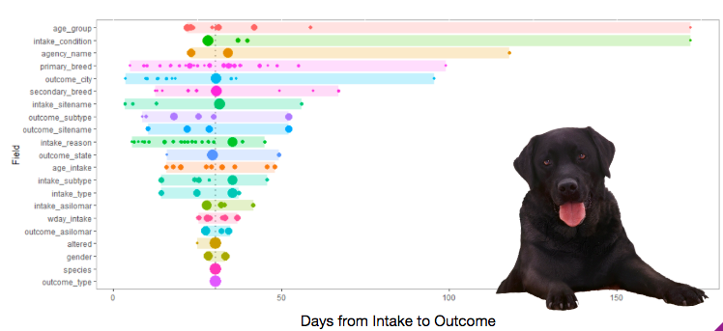
whereiation
plot_spread(
df = paws_data,
dep_var = “n_days"
)
High variation, a few large groups
outlier
High variation, several small groups
Small variation, 2 large groups

Slide 4
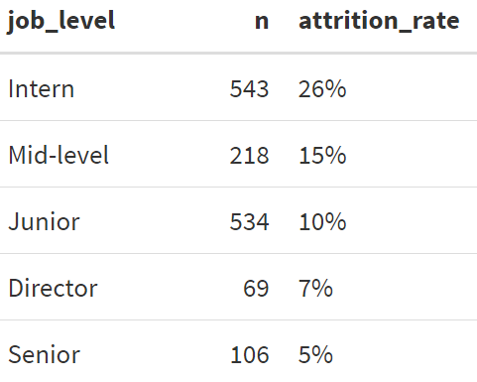
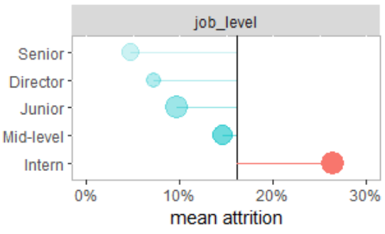
How does turnover vary by…
job_level
Overall avg turnover = 16%

Slide 5
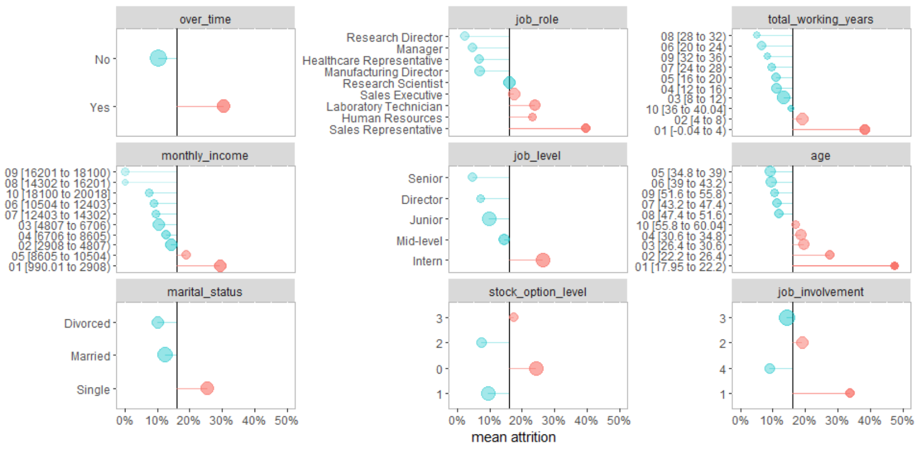
whereiation
plot_deltas( df = employee_attrition, dep_var = "attrition" )

Slide 6
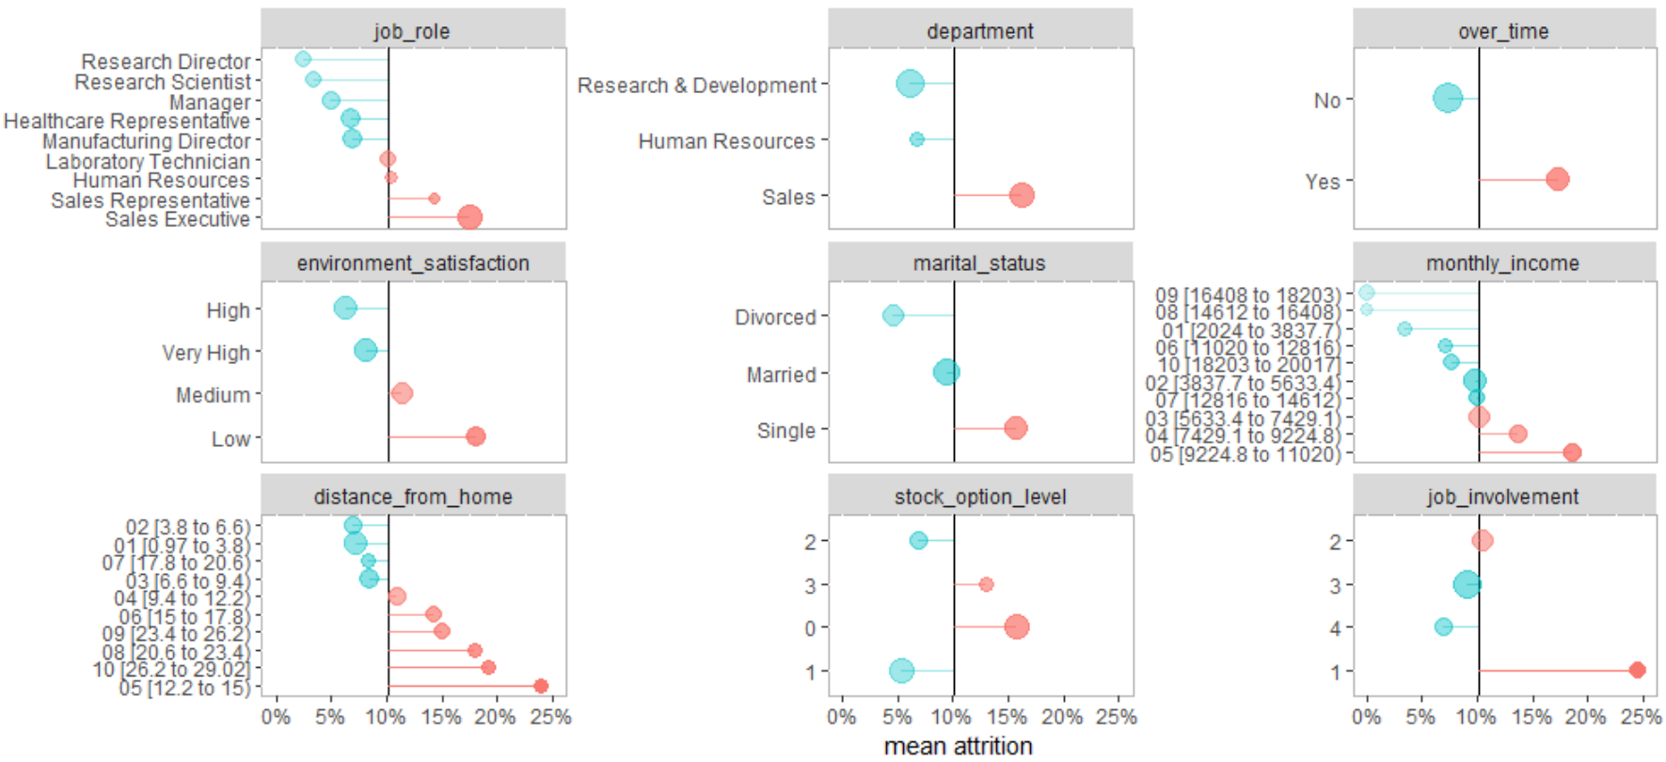
whereiation
employee_attrition %>% filter(job_level != "Intern") %>% plot_deltas(dep_var = "attrition“)
Mean now 10%

Slide 7
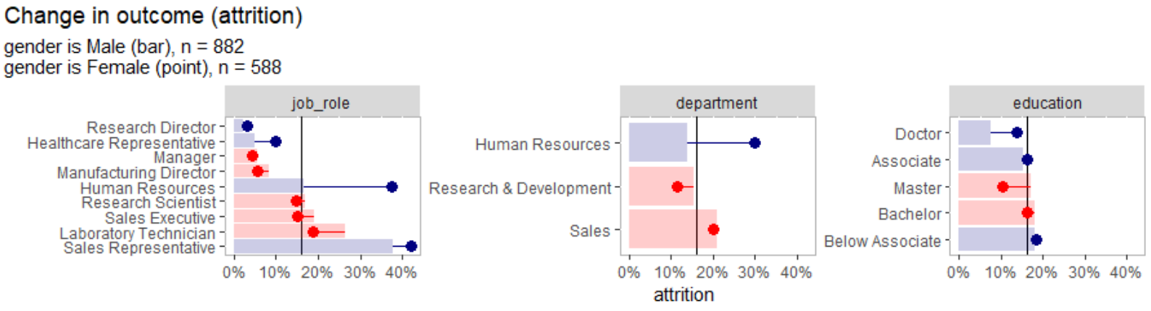
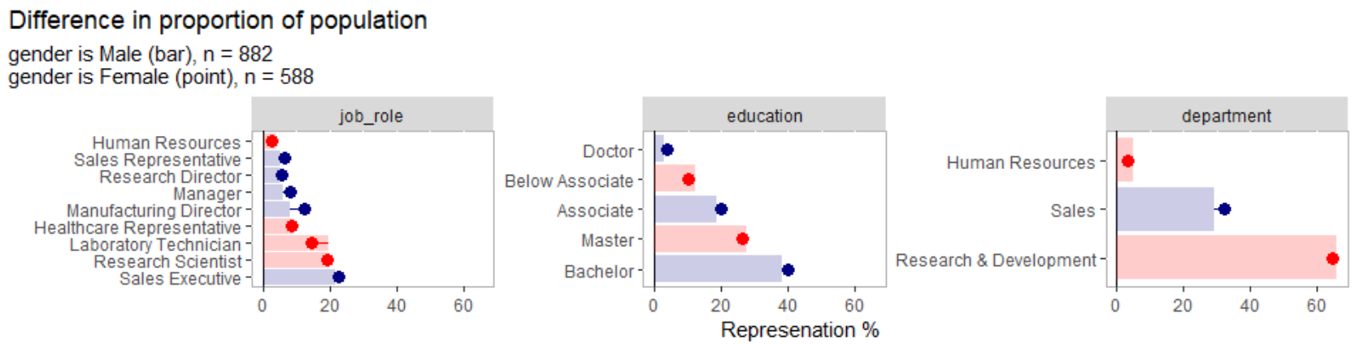
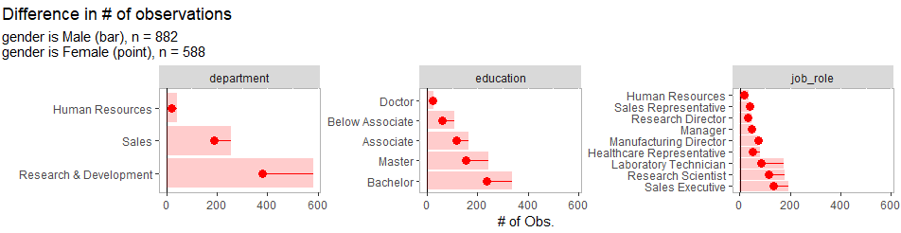
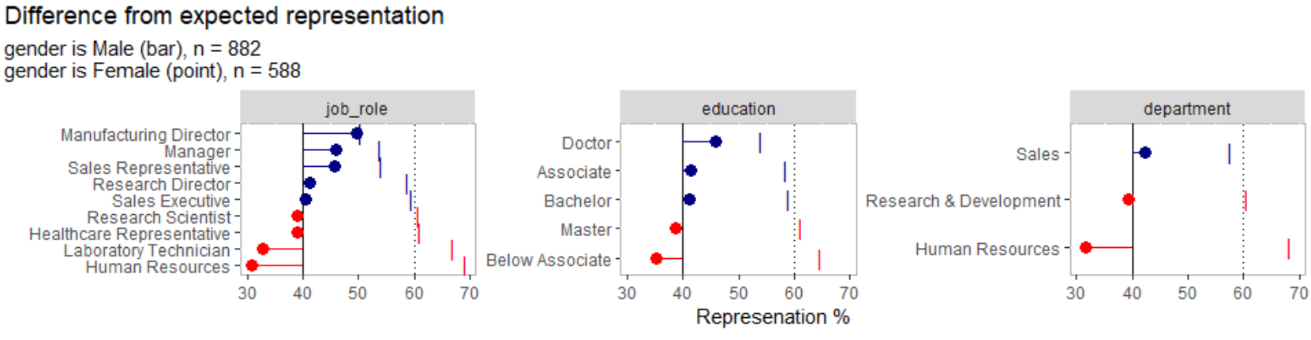
Compare two groups
plot_group_split(
df = attrition, split_on = "gender", type = ...
)
How is turnover in HR different for women vs men? It’s higher
What % of female employees are in research? ~65%
How many women are in research vs men? ~200 less
What % of research employees are women vs men? ~40%

Slide 8
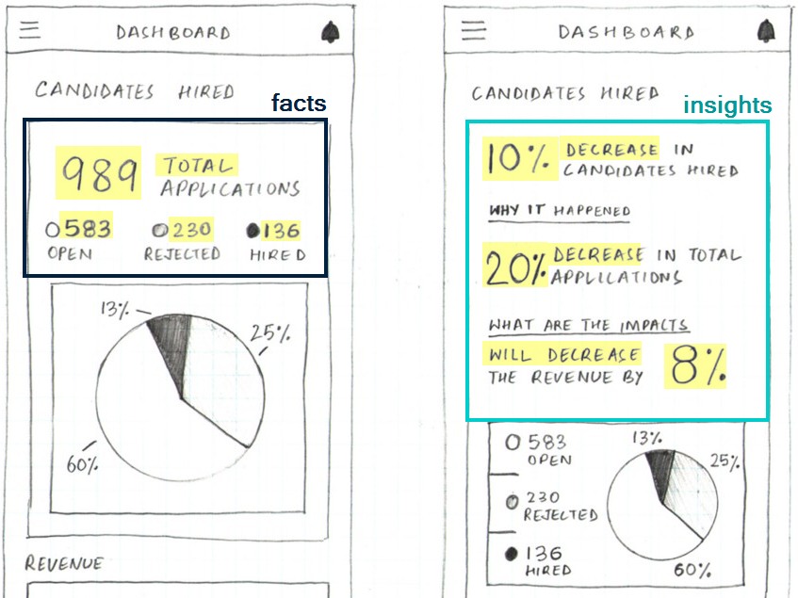
Building insightful dashboards isn’t easy
Facts
Easy out of the box
Risk of low adoption if takeaway isn’t obvious or actionable
Insights
More meaningful
High risk of technical debt

Slide 9
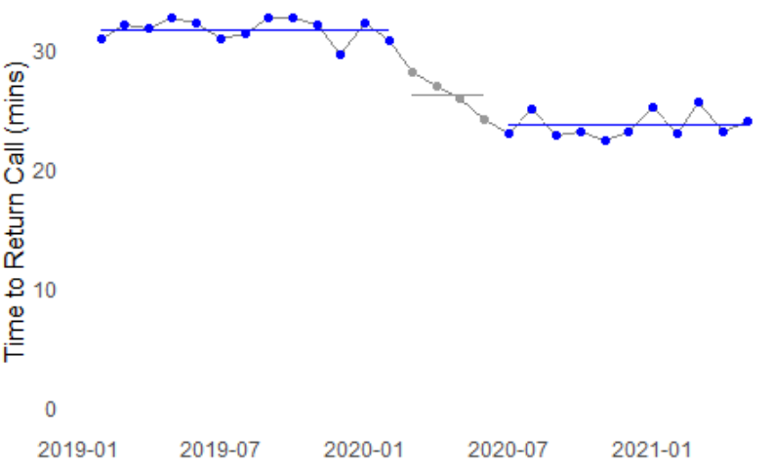
What’s a good title for this chart?
“Callback response times by month”
Vague
No insight
No lift
Static
“The avg. callback time has changed from 32 to 24 mins.”
Manual
Okay insights
Light lift
A little dynamic
“The avg. callback time has decreased by 8 minutes since COVID began (24 vs 32)”
Custom function
Good insights
Heavy lift - a few hundred lines of code to do well (technical debt)
Very dynamic

Slide 10

Enter headliner
headliner is an R package focused on informative titles
Given two values, headliner gives metadata about the difference
headline(32, 24)
#> increase of 8 (32 vs. 24)
headline(24, 32)
#> decrease of 8 (24 vs. 32)
headline(24, 32, return_data = TRUE) %>% view_list()
8 delta
25 delta_p
an 8 article_delta
a 25 article_delta_p
-8 raw_delta
-25 raw_delta_p
a -8 article_raw_delta
a -25 article_raw_delta_p
-1 sign
decrease trend
24 vs. 32 orig_values
Talking points

Slide 11
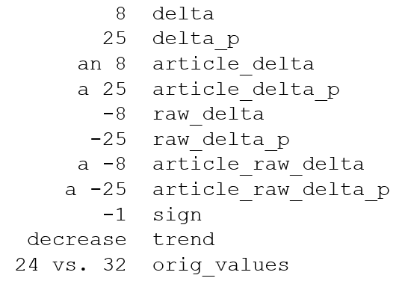
Enter headliner
Using glue()syntax, you can string together talking points:
my_age <- 36
glue("I am {my_age}")
#> I am 36
headline(
24, 32,
headline =
"The avg. callback time has {trend}d by {delta} minutes since COVID began ({orig_values})"
)
“The avg. callback time has decreased by 8 minutes since COVID began (24 vs 32)”
Dynamic insights
Very little code
Lower technical debt

Slide 12
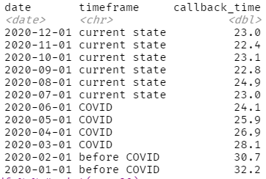
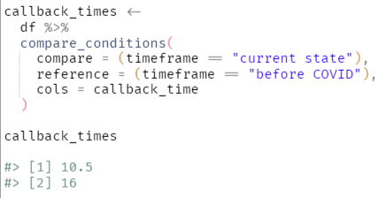
Helper functions
Aggregate metrics based on conditions
callback_times #> [1] 24 #> [2] 32

Slide 13
Calculations are completely soft-coded
Easily pass to headliner
callback_times #> [1] 24 #> [2] 32
callback_times %>%
headline(
"The avg. callback time has {trend}d by {delta} minutes since COVID began ({orig_values})"
) #> The avg. callback time has decreased by 8 minutes since COVID began (24 vs. 32)
Notes:
Dashboards & Reports
Put the metrics with the largest differences at the top
Emails
Qlik + R integration

Slide 14
Adding headlines row-by-row
df %>% add_headline_column(
compare = hours_asleep,
reference = hours_awake,
headline = "The {common_name} spends {delta} more {hours} {more} than {less}.",
plural_phrases = list( hours = plural_phrasing(single = "hour", multi = "hours") )
)

Slide 15
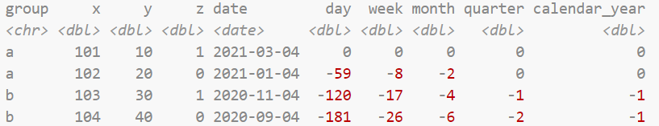
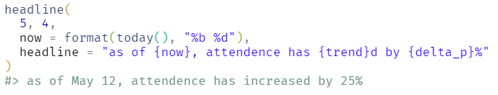
Other functionality
add_date_columns(date_col = date)
Helper function for comparing date ranges
[month = 0 vs month = -12]
Other benefits of glue()
Can add together
Can reference other variables

Slide 16

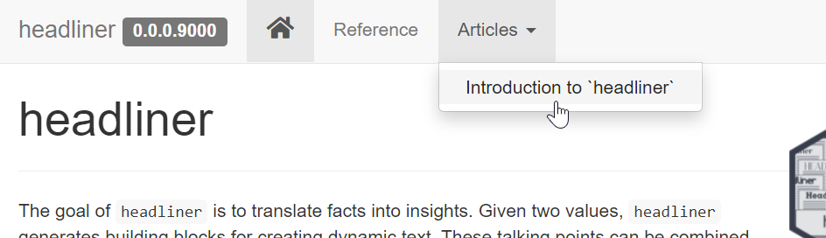
Thank you
github.com/rjake/
headliner
whereiation
simplecolors
shinyobjects

Slide 17
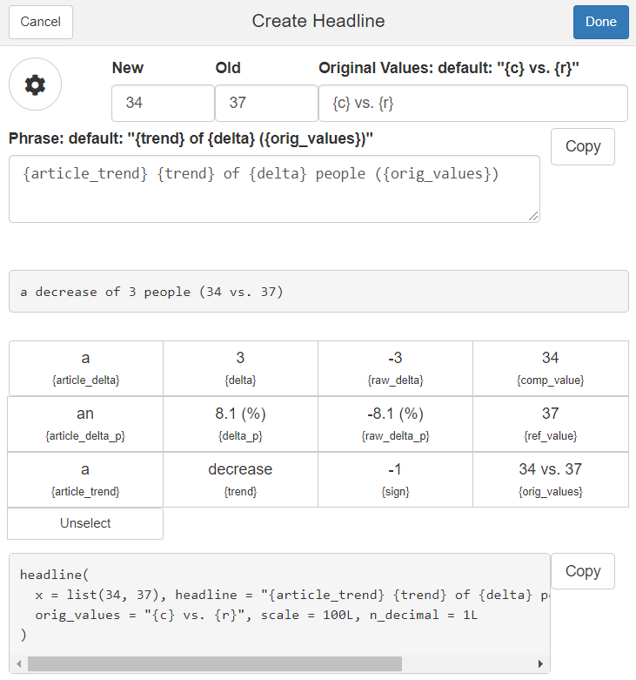
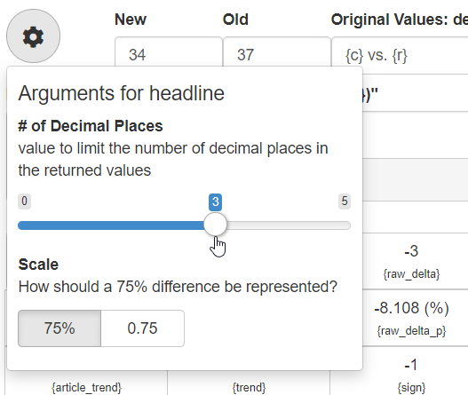
Working on a shiny add-in

